Slide 1
Evaluation of carotid intima-media thickness in systemic rheumatic disease patients
Viktor Pasovski, Gorica Ristić, Dragana Veljančić, Toplica Lepić, Ranko Raičević
Department of Neurology, Department of Rheumatology and Clinical Immunology, Military Medical Academy, Belgrade, Serbia

Slide 2
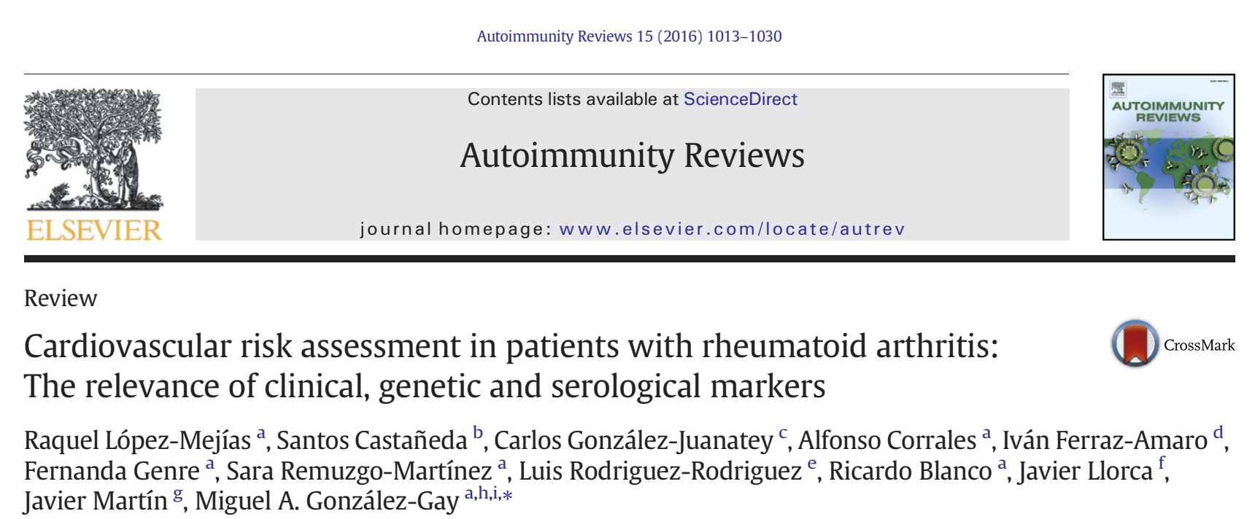
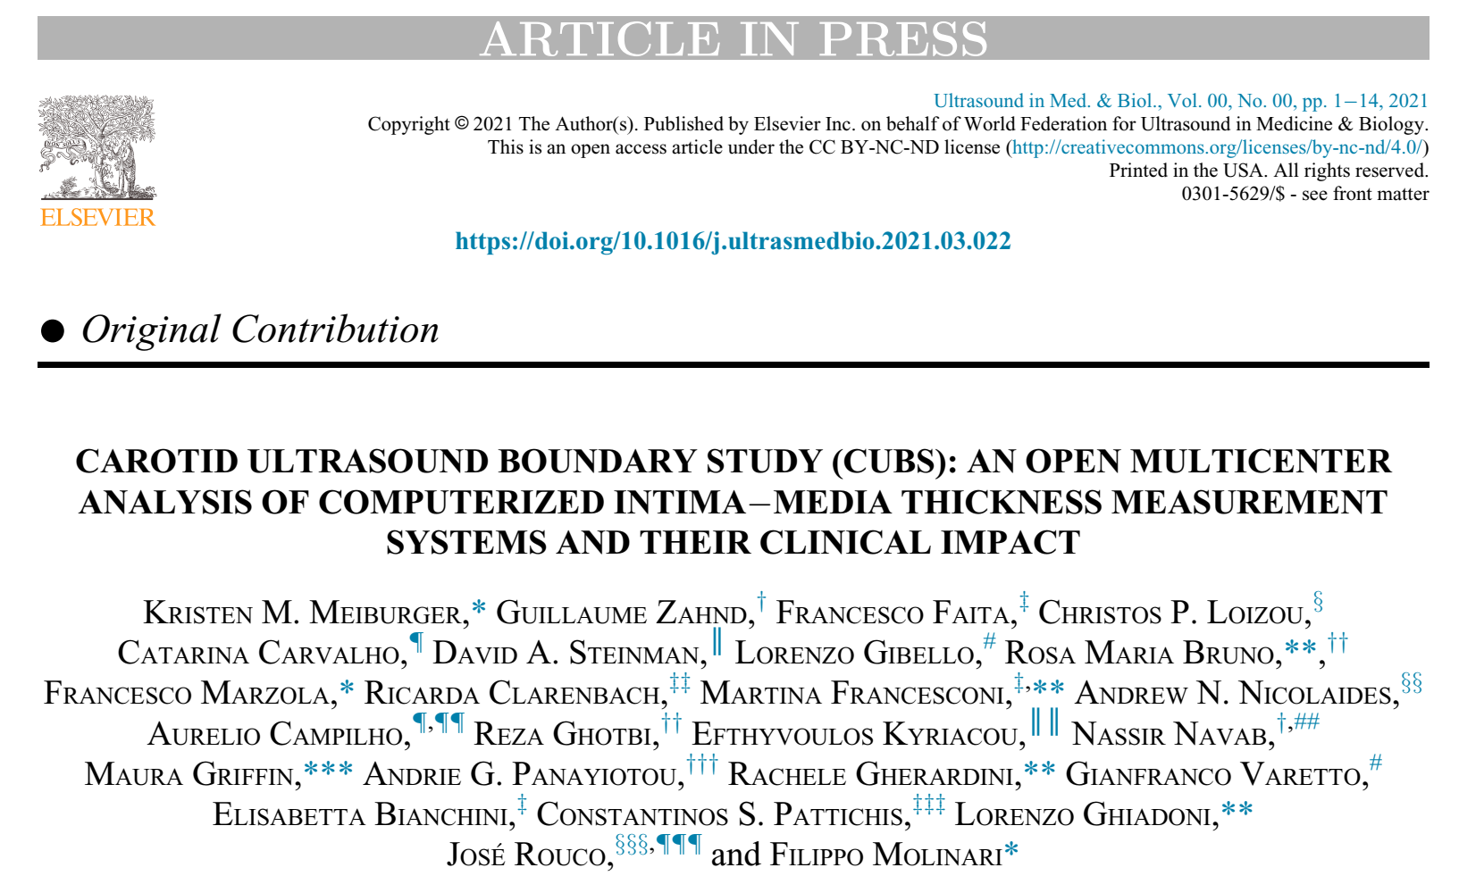
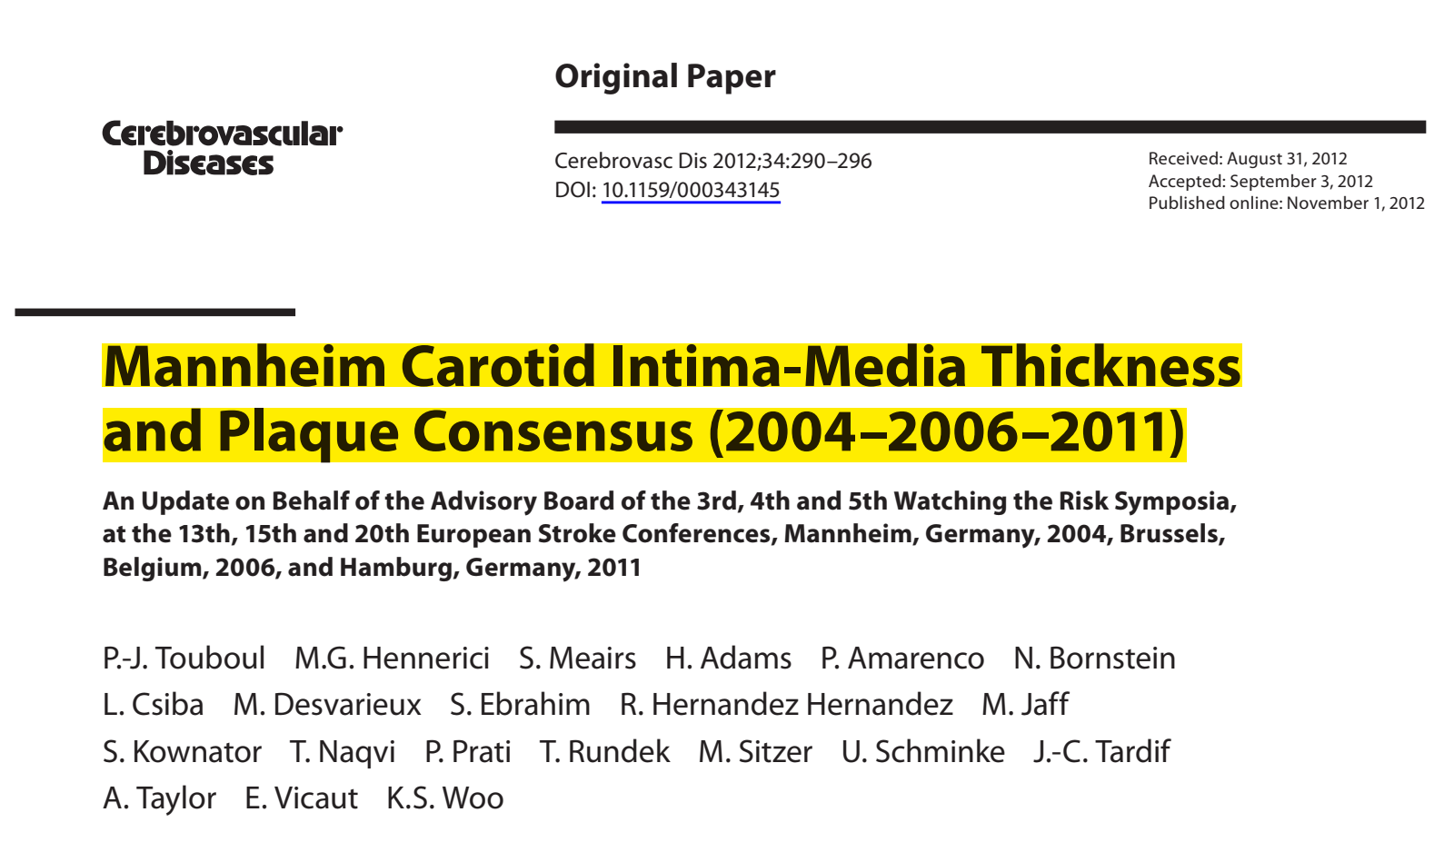
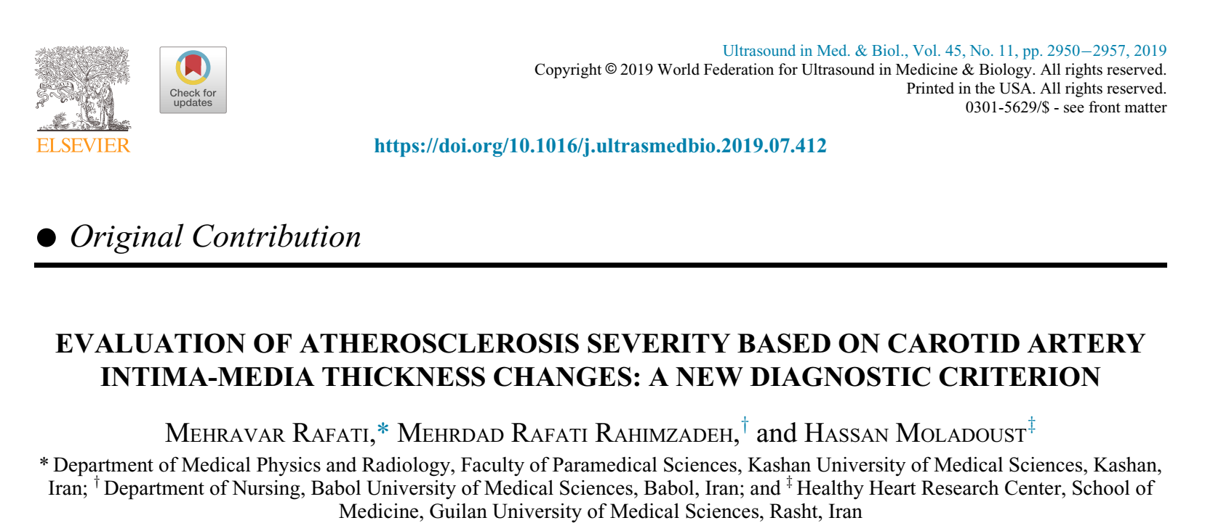

Slide 3
intima-media thickness (IMT) is a well-established marker of atherosclerosis and cardiovascular outcomes in clinical trials, evaluating the efficacy of cardiovascular risk factor modification
Carotid artery plaque further adds to the cardiovascular risk assessment
Several authors evaluated carotid IMT regarding the presence of atherosclerotic risk factors. Impact of inflammatory factors and anti-inflammatory treatment on carotid IMT was addressed only in some studies and just one analyzed the influence of the treatment duration.
Study intention was to determine factors associated with increased intima-media thickness (IMT) and potential cardiovascular risk of rheumatoid arthritis (RA) patients. Carotid IMT of the carotid arteries is a marker of subclinical atherosclerosis.
Martín-Martínez MA, González-Juanatey C, Castañeda S, Llorca J, Ferraz-Amaro, Fernández-Gutiérrez B, et al. Recommendations for the management of cardiovascular risk in patients with rheumatoid arthritis: Scientific evidence and expert opinion. Semin Arthritis Rheum. 2014; 44: 1–8

Slide 4
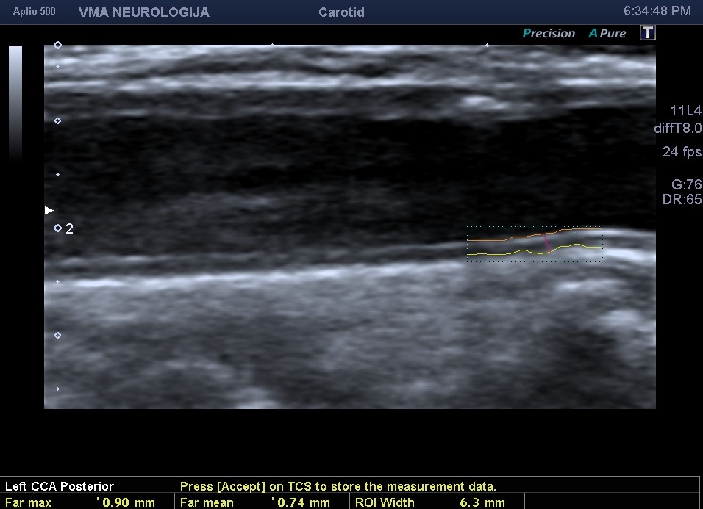
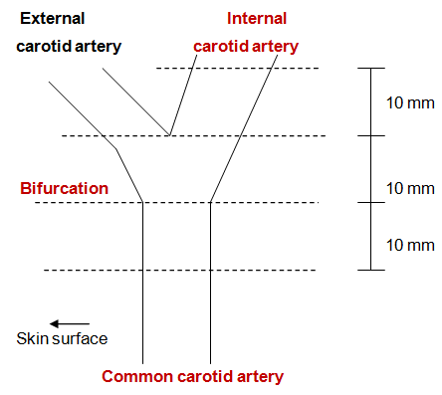
Methods – measurements of carotid IMT
IMT was measured in both left and right carotid arteries in plaque-free sections at the levels of CCA (10 mm proximal to the dilatation of the carotid bulb), the carotid BF (10 mm proximal to the flow divider) and the ICA (10 mm distal to the flow divider), according to the protocol used in the ARIC study (Atherosclerosis Risk in Communities).
Burke GL, Evans GW, Riley WA, at all. Stroke 1995; 26:386-91

Slide 5
Methods – measurements of carotid IMT
Three IMT measurements were performed at all segments providing a total of 18 measurements per person, 9 at each side
Average mean and average maximal (max) IMT values were calculated at each segment of both carotid arteries
According to these method, 6 IMT values were obtained for all carotid levels, 3 mean and 3 max values.
Common carotid artery: CCA_{max;} and CCA_{mean}
Carotid bifurcation: BF_{max} and BF_{mean;}
Internal carotid artery: ICA_{max} and ICA_{mean}
Atherosclerotic plaque was defined as IMT>1.5 mm
Stein JH, Korcarz CE, Hurst RT, Lonn E, Kendall CB, Mohler ER, et al. American Society of Echocardiography Carotid Intima-Media Thickness Task Force. J Am Soc Echocardiogr. 2008; 21: 93–111

Slide 6
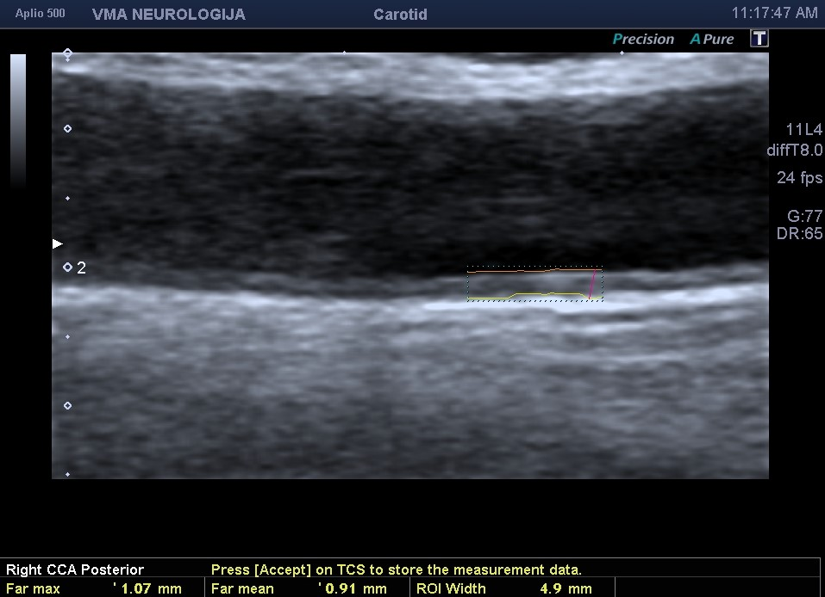
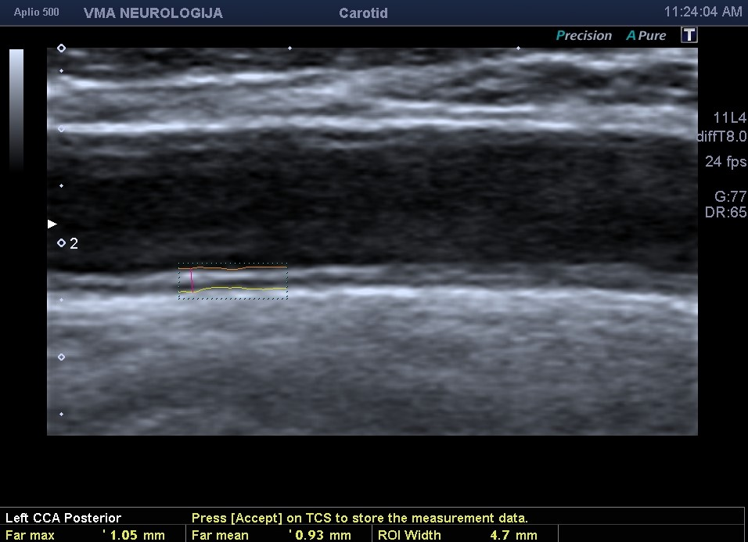
Design of the study
The insonation was performed in 42 non-diabetic, normotensive, female RA patients and 32 matched healthy controls (age 45.3±10.0 vs. 45.2±9.8 years) at common carotid artery to determine the IMT
Mean and maximal IMT were calculated from 3 measurements at each site. Clinical work-up included laboratory analyses, determination of the disease activity and evaluation of treatment
Von Willebrand factor (vWF) activity was used as rheumathoid arthritis confirmation.

Slide 7
Results
RA patients had increased IMT (mm) in comparison with controls (IMTmax: 0.764±0.148 vs. 0.703±0.100, IMTmean: 0.671±0.119 vs. 0.621±0.085.
Parameters associated with IMT in RA patients were: age, body-mass index, smoking, rheumatoid factor concentration, eritrocyte sedimentation rate, and duration of methotrexate+chloroquine therapy (inverse correlation).
Multivariate regression analysis revealed that RA is an independent risk factor for increased IMT.
vWF activity was significantly higher in participants with subclinical as well as in participants with atherosclerotic plaques than in those without.
Factors correlating with IMT in the controls were: age, BMI, total cholesterol, LDL-cholesterol, total/HDL cholesterol, triglycerides and glycaemia.

Slide 8
Average mean and average max values of IMT of the carotid arteries in patients with RA and healthy controls

Slide 9
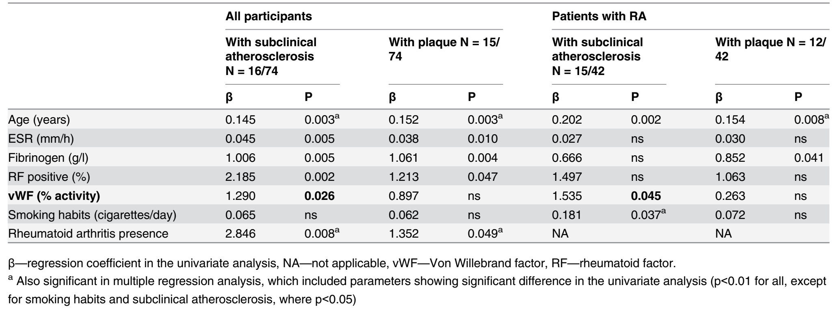
RESULTS Univariate and multivariate logistic regression analysis of association between traditional or RA related cardiovascular risk factors with the presence of subclinical atherosclerosis (mean IMT+2SD of the controls) or atherosclerotic plaque (IMT>1.5 mm) in the entire study group and patients with rheumato arthritis

Slide 10
Conclusions
Despite a favourable risk profile, our female RA patients had significantly enlarged carotid IMT than controls.
RA itself was an independent risk factor for increased IMT
Impact of chronic inflammation on atherosclerosis was confirmed by negative correlation of IMT and duration of anti-inflammatory treatment.

